Slide 1

IMPACT Implementation Guide – Best Practice & Design
May 8, 2019

Slide 2
Agenda
Intro
Implementation Methods
Demo Server
Research

Slide 3
What is FHIR?

Slide 4
What is FHIR & (3+n)-Tier Architecture – Enabling Applications
A standard for exchanging healthcare information electronically.
The basic building block in FHIR is a Resource.
Resources either by themselves or when combined, satisfy the majority of common healthcare use cases.
Provides a common structured language for FHIR-enabled applications to communicate.
Standards are very loose for what data you can use.
Notes:
FHIR is not software. It’s a standard/specification.
Can provide extensions for anything not in base resources.

Slide 5
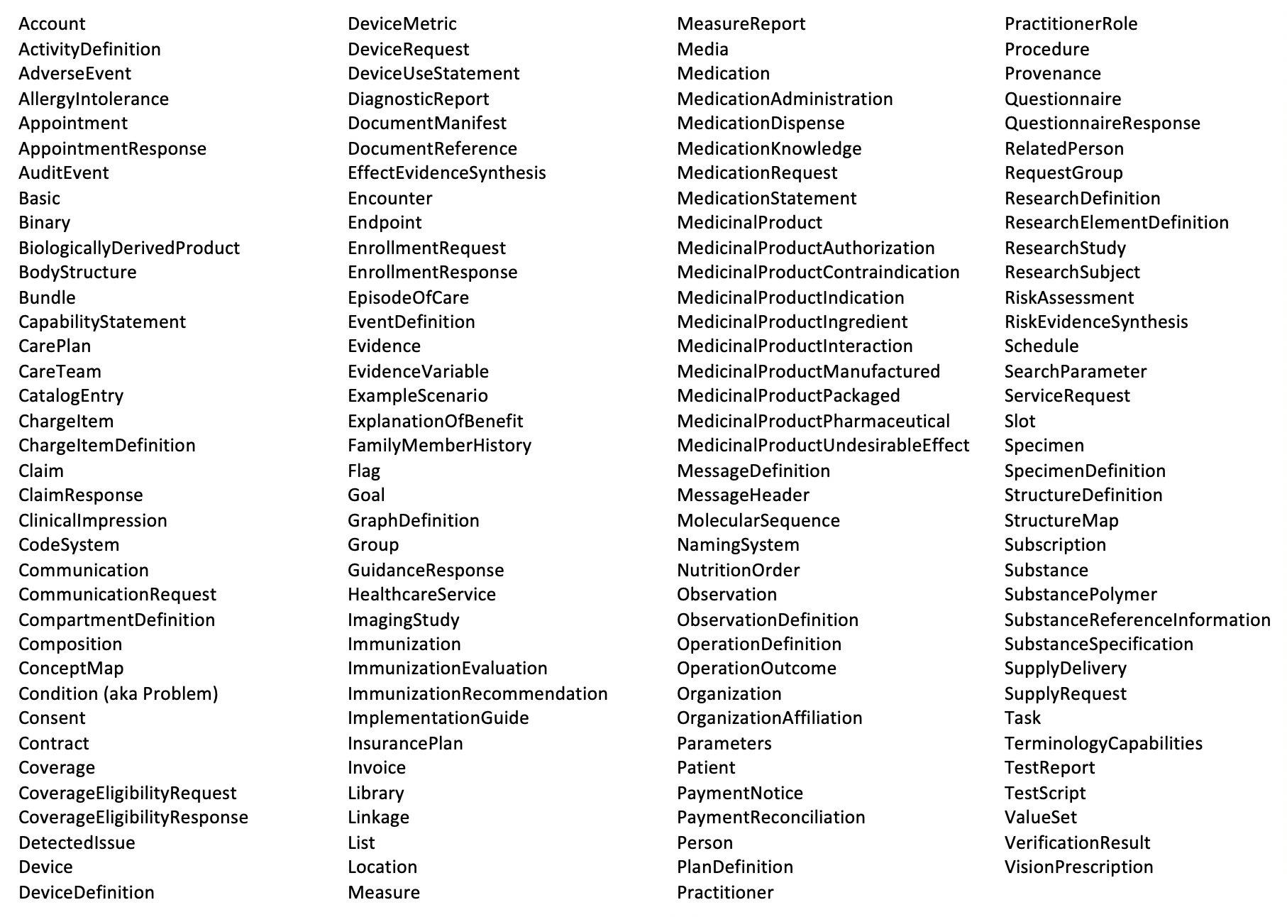
FHIR Resources
Notes:
Not meant to read this whole list. Just note that there are lots!

Slide 6
Using FHIR Effectively
Understand which resources are needed to satisfy your use cases.
Develop implementation guides to constrain base resources.
Iteratively test implementation guides to ensure correctness.
Migrate data from existing systems if needed.

Slide 7
Reference Basics & Demo

Slide 8
What is an Implementation Guide? Design Principles
Bottom-line – Is a way to specify system using existing models
Resource: Those models as objects, eg Patient, Questionnaire
Profile: Specific naming for particularly situations
Structure Definition: Way to say this structure, “model for the model”
“Two-part Translation” – Domain Model to (FHIR) Server
Domain: Post-Acute Care, a la IMPACT
System: (FHIR) Server Implementation
Interoperation = Domain Model <~> System

Slide 9
Current DEL IG [DRAFT]
HAPI FHIR Server

Slide 10
PACIO Working Group
Standard Implementation & Implementation Standards
Provide implementation based on the standards
Prove the standards can be based in implementation
Translating Use Cases into Needed Structure
Profile : Service Settings
Observations : Data Element
Joint Resource(s): QuestionnaireResponse & Questionnaire
Internal resources for domain groupings
Other messaging & tools for involved usages: OAuth 2.0, CDS Hooks
Notes:
**Here start demo**
-Screenshots: Big Picture

Slide 11
Working Materials Demo
HAPI FHIR Server

Slide 12
IG Specification

Slide 13
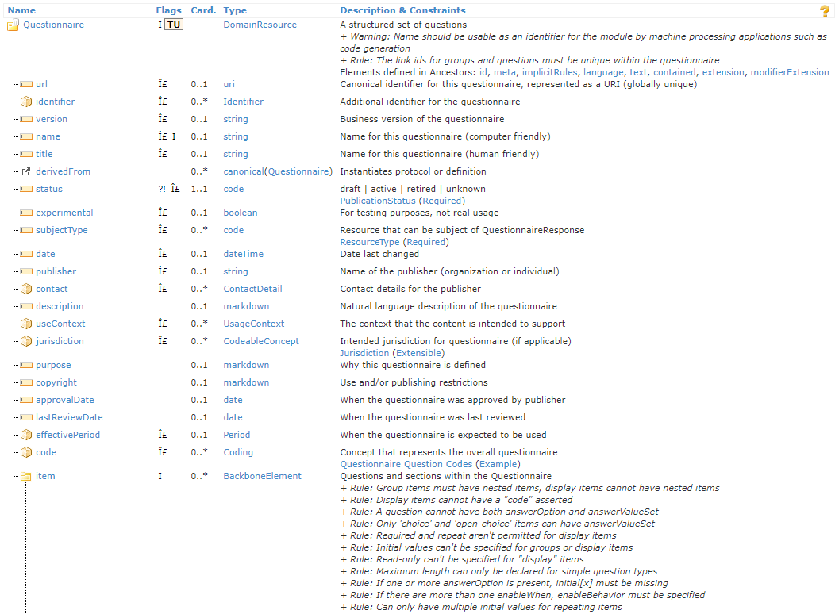
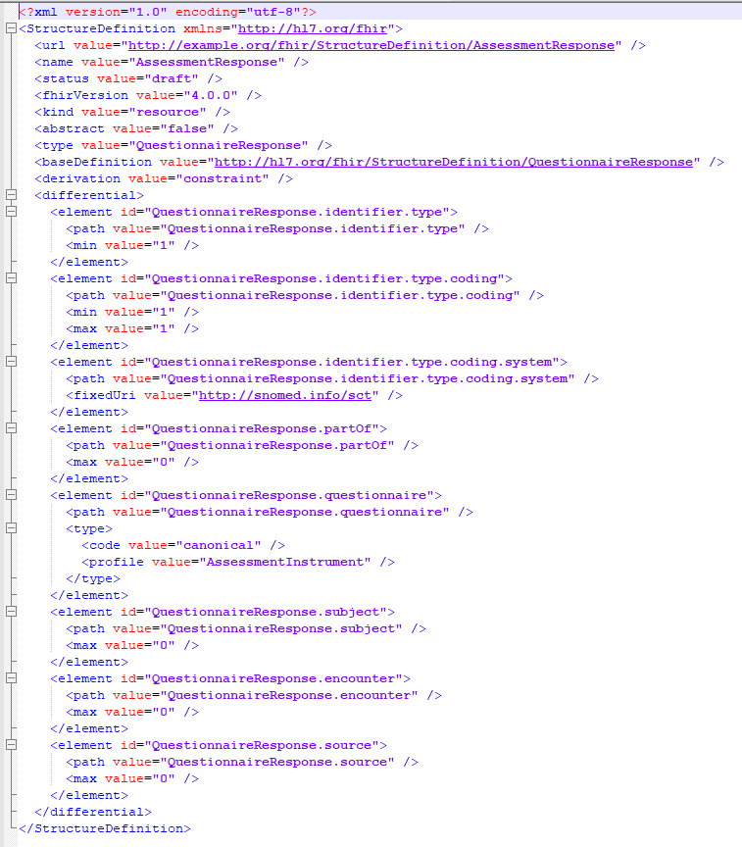
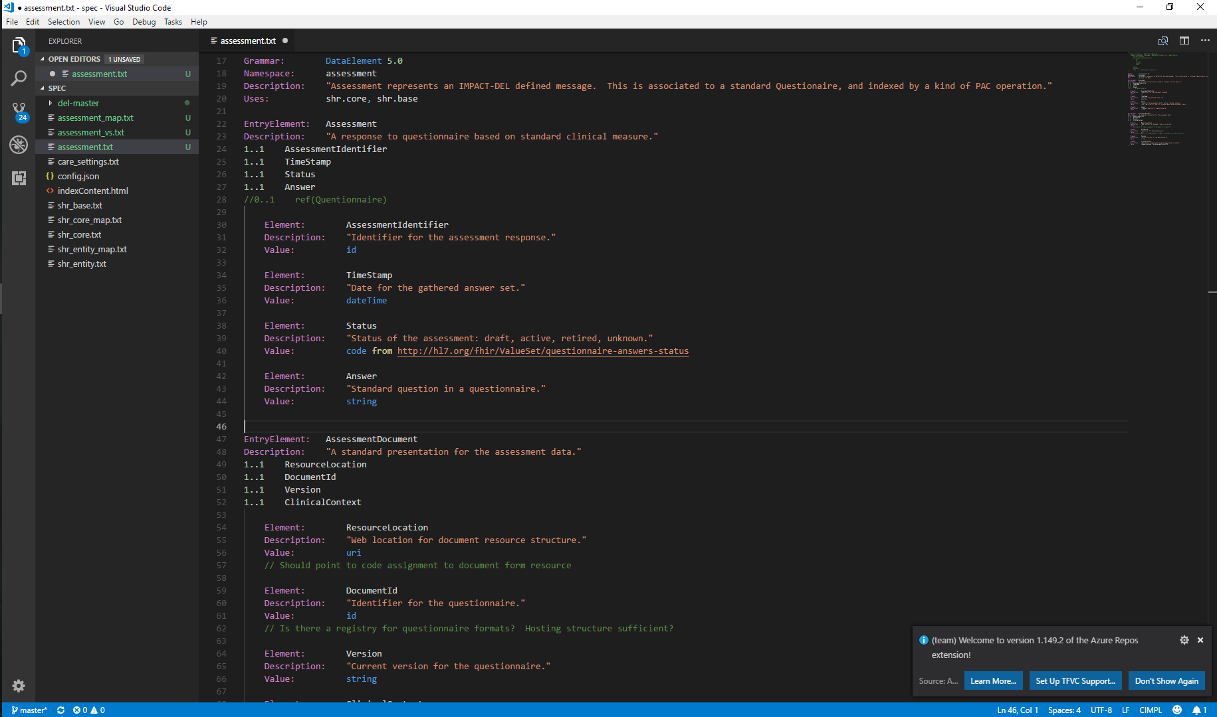
FHIR Specification
Based on This
Into This

Slide 14
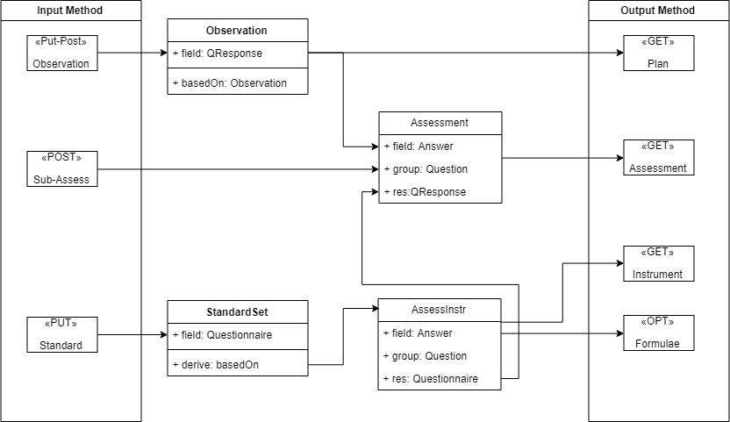
DEL Representation Diagram
REST Input-Out
Use Cases:
Combination
Layering
Guided Decomp
Resources = id
Structure = map
Notes:
Remake Diagram with cleaner lines
Add description to right

Slide 15
Design Patterns – Decisions To Consider
Capabilities & Operation
Use Cases → Capabilities
Methods → Operations
Foundation
Domain & Compartments – Contextual information
Bundles – Standard in-out formats
Intrinsic Structure
Slicing, eg rule-set per clinical context
Extensions – add additional information
Further Kinds
Derived Profiles – Standard internal profiles, eg assessment contexts
Notes:
Make Table

Slide 16
Going Forward

Slide 17
Development – Current & Future Status
Development Done
Create FHIR server
Validate resources against StructureDefinition
Initial implementation guide generation
Loading implementation guides to server
Development To Do
Get everything working with R4
Open server so others can view resources
Finish implementation guide
Authentication and authorization

Slide 18
Research – Ideas & Useful Collaboration
Research Have Done’s
DEL Modeling Options
Initial collection about design
Specification procedure
Diagrammatic language
Algebraic Principles
Context Space
Research To Do’s
Formalize from Use Cases
Index IG development
Test porting diagrams to modeling language
Resource basis
Slicing vs extensions
REST Methods

Slide 19
Appendix – Materials

Slide 20
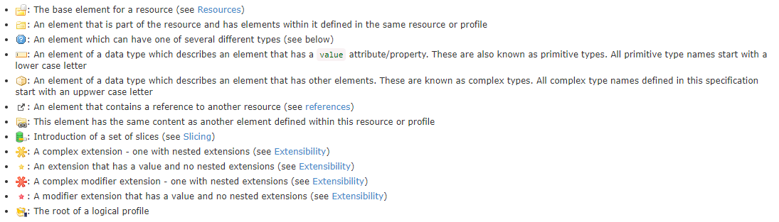
IG Design Primitives &

